Slide 1
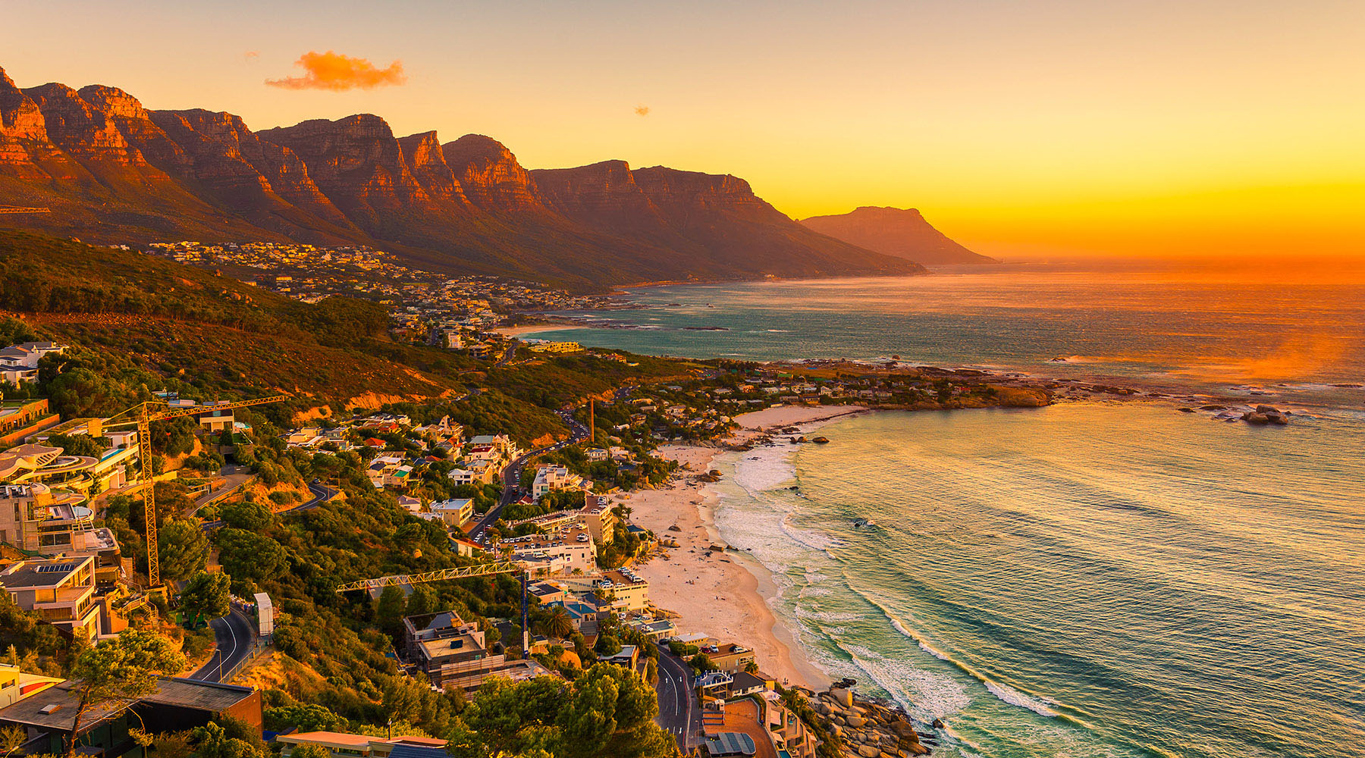
South Africa
Economic Performance

Slide 2
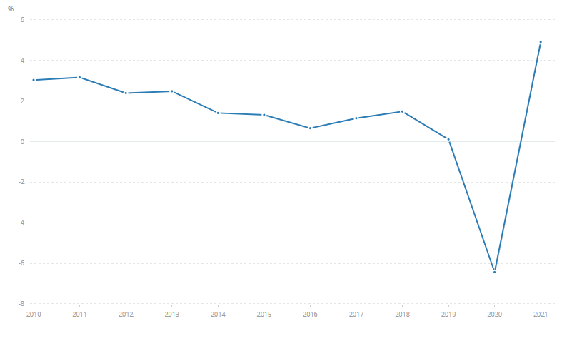
Economic Growth
Economic Growth rate gradually falling since 2010
Remained positive until 2019
Dropped steeply to -6% in 2020
Bounced back to 5% in 2021
Economic Growth as a percentage of GDP
Time
Data: World Bank
Notes:
South Africa’s Economic Growth rate (shown here as a percentage of GDP) has been steadily declining since the turn of the last decade, falling from an annual growth rate of roughly 3% to almost 0% in 9 years. This caused a depression in the country.
Economic Growth took a steep dive in 2020 (all dates shown here are from Q4) down to -6% (negative growth) due to the pandemic, but after this quickly bounced back to higher than recently seen, with the economy growing by 5% in 2021 .

Slide 3
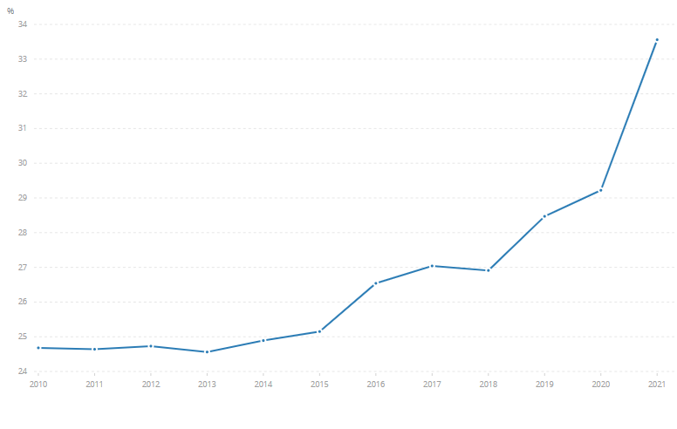
Unemployment
High average unemployment throughout the last decade
Began to increase in 2013
Large jumps in 2015, 2018 and 2019
Unemployment spiked in 2020 due to the pandemic
COVID-19 Pandemic
% of Population that are unemployed
Time
Data: World Bank
Notes:
South Africa’s Economic Growth rate (shown here as a percentage of GDP) has been steadily declining since the turn of the last decade, falling from an annual growth rate of roughly 3% to almost 0% in 9 years. This caused a depression in the country.
Economic Growth took a steep dive in 2020 (all dates shown here are from Q4) down to -6% (negative growth) due to the pandemic, but after this quickly bounced back to higher than recently seen, with the economy growing by 5% in 2021 .
At the beginning of 2020, the unemployment rate spiked, and as of Q4 of 2021 has not returned to normal. This was due to the pandemic.
In an attempt to reduce unemployment rates, the South African government are investing in the creation of more jobs, subsidising certain industries, and campaigning for people to look for work in the aftermath of the pandemic.

Slide 4
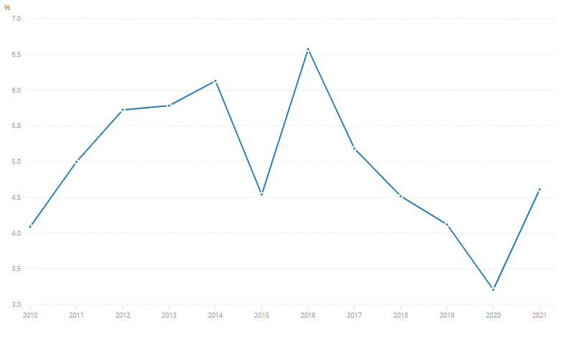
Inflation
Inflation has remained above 3% for the last decade
Inflation is higher than is ideal, with large fluctuations
In 2020 inflation was at its lowest (3.25%)
It has now began to increase, and is currently at 7.8%
% Inflation
Time
Data: World Bank
Notes:
South Africa’s inflation rate has remained above 0% in the last decade, peaking at 6.5% in mid 2016, and being at it’s lowest in 2020.
Inflation is higher than is ideal, and is far from being stable, with relatively large fluctuations.
Recently (2020-Present), inflation has begun to go up again, and is currently at a rate of 7.8%.

Slide 5
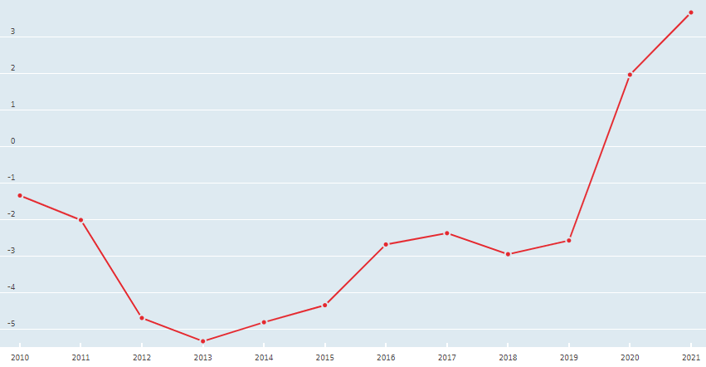
Balance of Payments
2010-2019 there was a trade deficit
Deficit became a surplus in 2019
Large spike in 2019 as surplus increased very quickly
This boosted economic activity and contributed to growth
Current account balance as a percentage of GDP
Time
Data: OECD
Notes:
From 2010 until mid 2019, South Africa was experiencing a trade deficit, importing more than they exported.
However, this trade deficit became a surplus in mid 2019, and the current account balance soared from -2.5% in 2019 to 3.5% in 2021. This was due to export value and quantity growing significantly during this period.
This will have contributed to the economic growth shown earlier.

Slide 6
COnclusion
South Africa’s economy is subject to major fluctuations, and is therefore very unstable.
Unemployment is very high when compared to much of the world, and this can cause lac of economic growth (more people on benefits, less output, etc.).
Balance of Payments has recently turned from a trade deficit to a surplus, perhaps signalling an increase in economic activity and growth.
The pandemic has severely affected the economy, but it has been able to bounce back to become stronger than before.
Notes:
South Africa’s economy is subject to major fluctuations, and is therefore very unstable.
Unemployment is very high when compared to much of the world, and this can cause lac of economic growth (more people on benefits, less output, etc.).
Balance of Payments has recently turned from a trade deficit to a surplus, perhaps signalling an increase in economic activity and growth.
The pandemic has severely affected the economy, but it has been able to bounce back to become stronger than before.

